Slide 1
Automated pet feeder

Slide 2
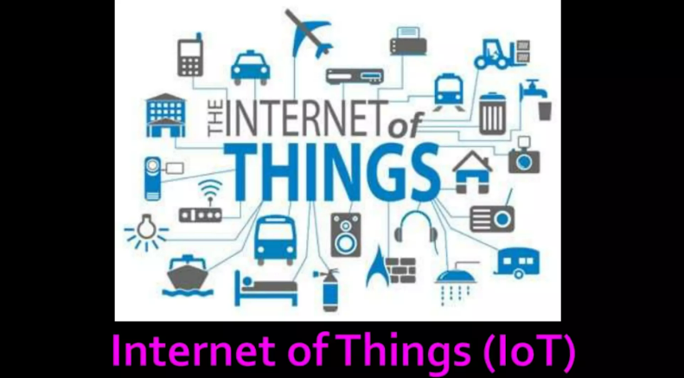

Slide 3
What is iot?
The internet of things, or IoT, is a network of physical devices. These devices can transfer data to one another without human intervention. Iot devices are not limited to computers or machinery. The internet of things can include anything with a sensor that is assigned a unique identifier (UID). The primary goal of the IoT is to create self-reporting devices that can communicate with each other (and users) in real time.

Slide 4
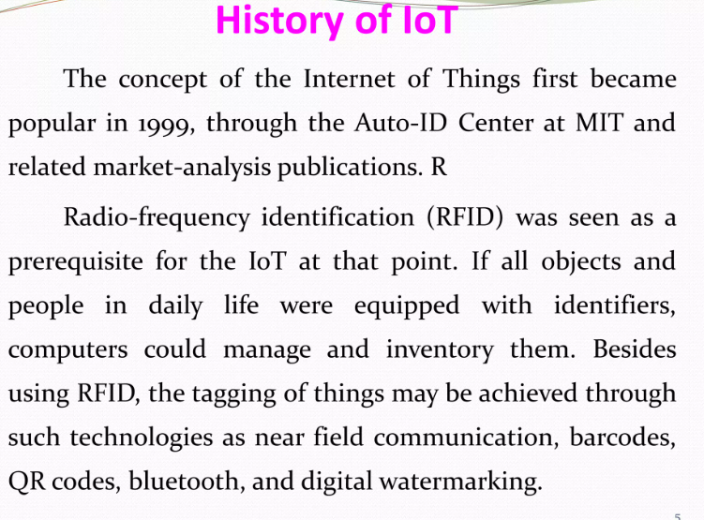

Slide 5
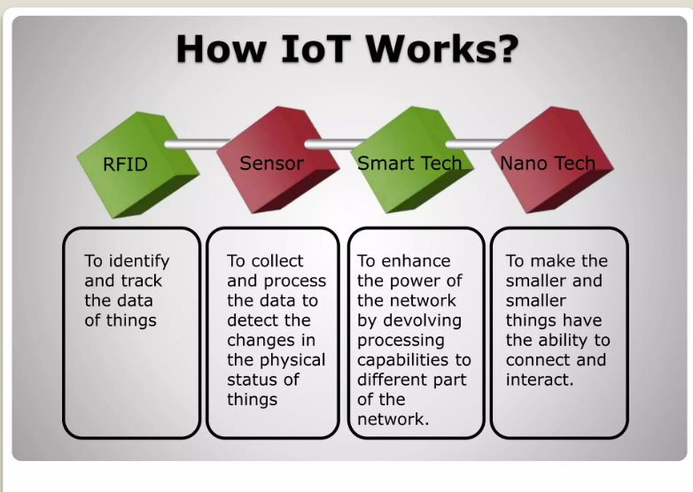

Slide 6
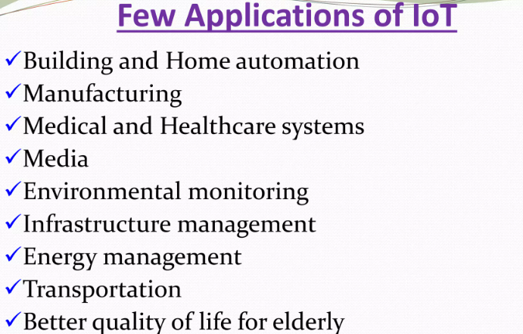

Slide 7
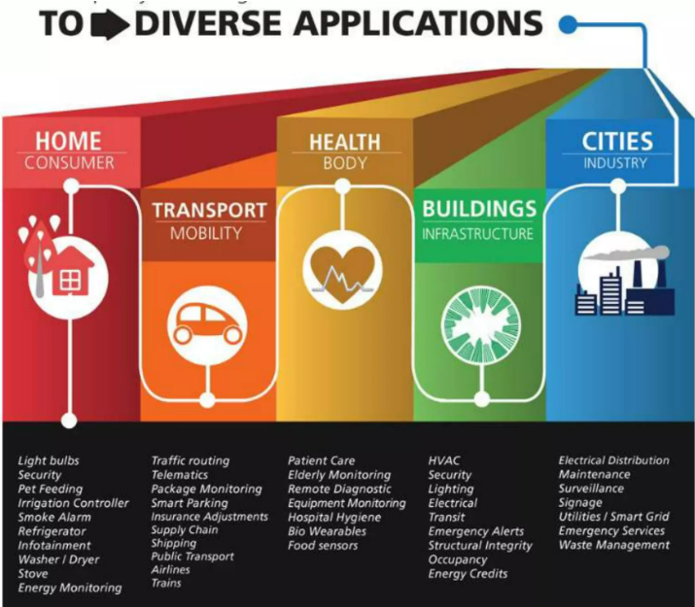

Slide 8
INTRODUCTION
The IoT pet feeder control system is a mini-project designed to remotely control a pet feeder using an ESP8266 microcontroller. This system allows users to schedule feeding times for their pets and provides a web interface for monitoring and controlling the pet feeder. Additionally, it includes the capability to enable or disable a webcam feed for live monitoring of the pet.

Slide 9
HARDWARE COMPONENTS
ESP8266 MICROCONTROLLER
SERVO MOTOR
WEBCAM
POWER SUPPLY

Slide 10
ESP8266 MICROCONTROLLER
The central processing unit that controls the entire system.
Manages WiFi connectivity and serves as the brain for processing requests.

Slide 11
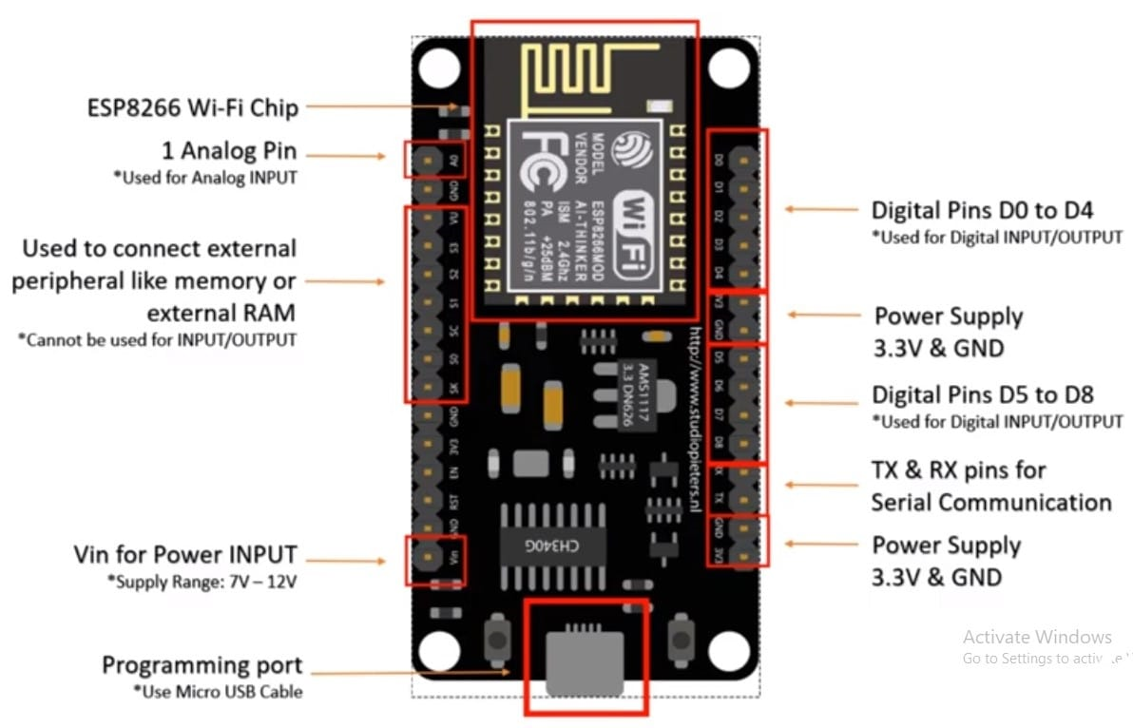

Slide 12
SERVO MOTOR
Mechanism for controlling the pet feeder's opening and closing action.
Attached to a designated pin on the ESP8266 for control.

Slide 13
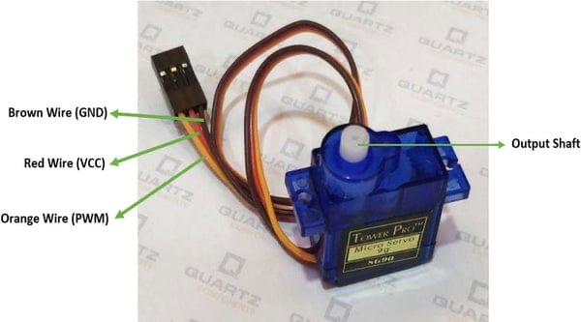

Slide 14
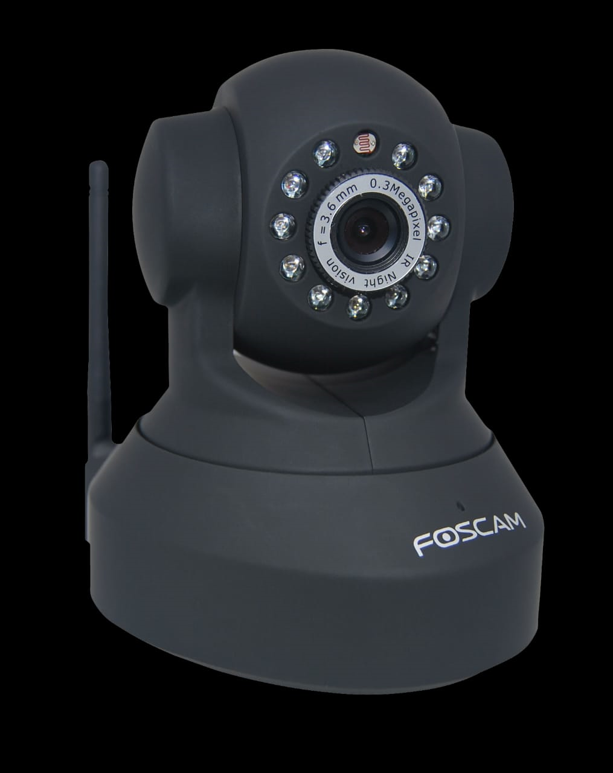
WEBCAM
Captures live video feed for remote monitoring.
Connected to a separate system, and its status is toggled through the esp8266.

Slide 15
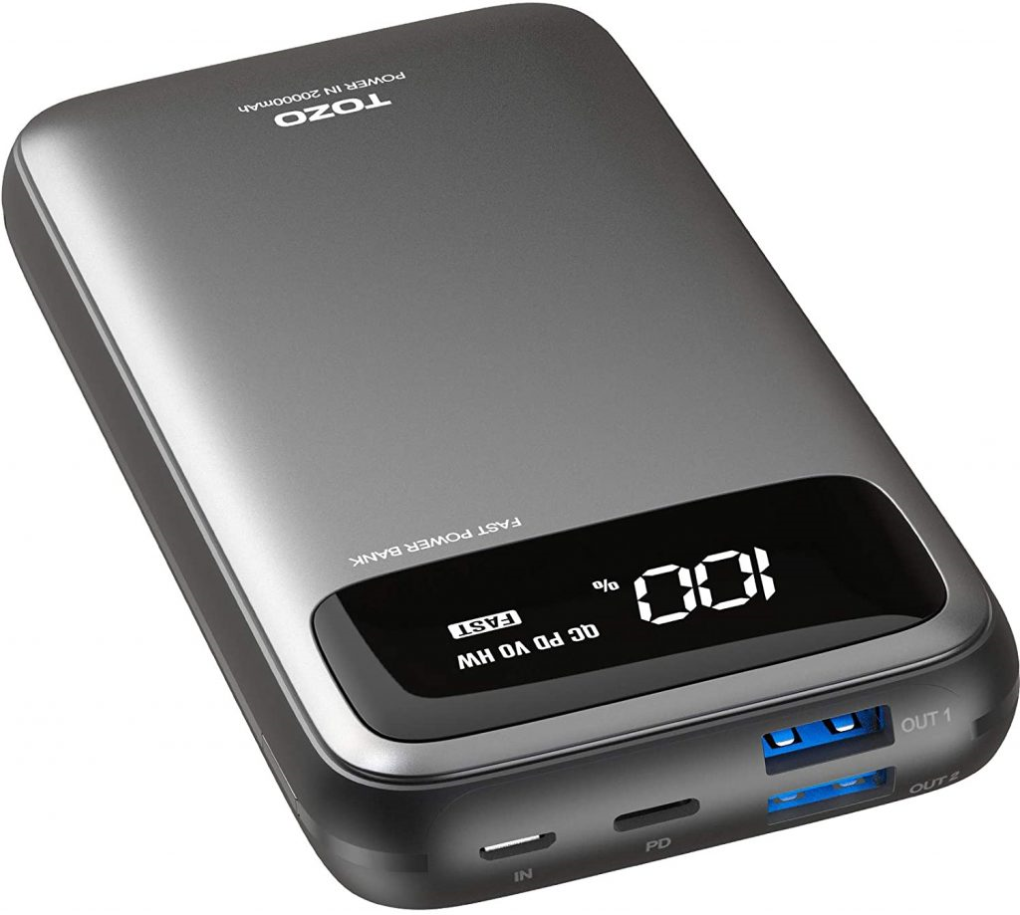
POWER SUPPLY
Provides the necessary power to the ESP8266, servo motor, and webcam.

Slide 16
Software Stacks
Pet feeder
1. Arduino(C/c++)
2. HTml
3. css
4. JavaScript
Cam app
1. Python
2. opencv
3. yolo(gpu Accelerated)
4. haar

Slide 17
SOFTWARE COMPONENTS used in pet feeder
Arduino Sketch
ESP8266WIFI Library
ESP8266webserver Library
Servo Library
ESP8266httpclient Library
Web Interface (HTML, CSS, JavaScript)

Slide 18
Arduino sketch
Written code that runs on the ESP8266.
Manages the main logic for handling HTTP requests, servo control, feeding intervals, and webcam toggling.

Slide 19
Esp8266wifi library
Enables the ESP8266 to connect to a local WiFi network, facilitating communication with the web interface.

Slide 20
esp8266WEBserver library
Implements the web server functionality on the ESP8266, handling incoming HTTP requests and serving web pages.

Slide 21
Servo Library
Provides functions to control the servo motor, allowing the opening and closing of the pet feeder.

Slide 22
ESP8266HTTPCLIENT LIBRARY
Facilitates making HTTP requests to external systems, in this case, used for fetching the webcam feed.

Slide 23
WEB INTERFACE (HTML, CSS, JavaScript)
HTML markup for creating the structure of the web pages.
CSS for styling the web pages and ensuring a user-friendly interface.
JavaScript for dynamic updates on the web interface and potentially asynchronous communication with the server.

Slide 24
Working of automated pet feeder
This IOT pet feeder control system utilizes an ESP8266 microcontroller for wifi connectivity and hosts a web interface.
The servo motor controls the pet feeder door based on scheduled feeding times.
Users can toggle a webcam feed for live monitoring through the web interface.
The system follows a client-server architecture, with the ESP8266 acting as the server.
The code structure includes wifi configuration, web server setup, servo control, and webcam feed toggling.

Slide 25
Users can interact with the web interface to control the servo, toggle the webcam, and update feeding frequency settings.
The project successfully provides a remotely controllable pet feeder with scheduling capabilities, and future improvements could include implementing security features and enhancing user interface friendliness.
Overall, the system demonstrates a practical application of iot technology in pet care.

Slide 26
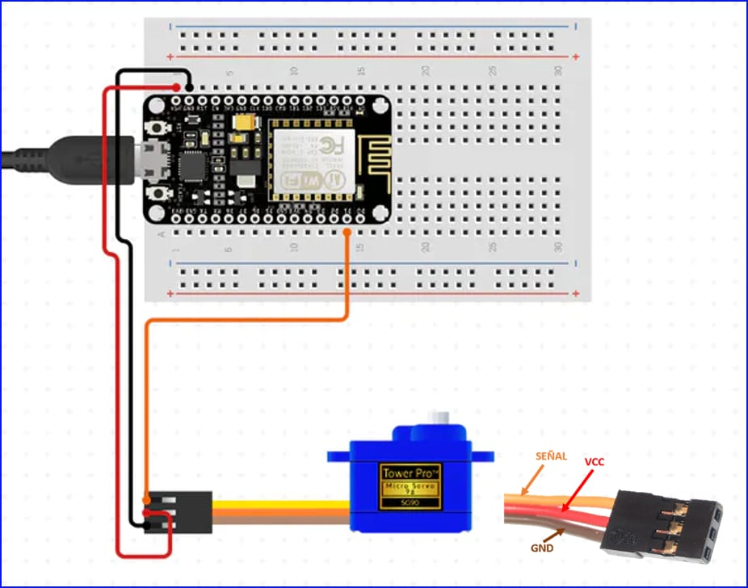

Slide 27
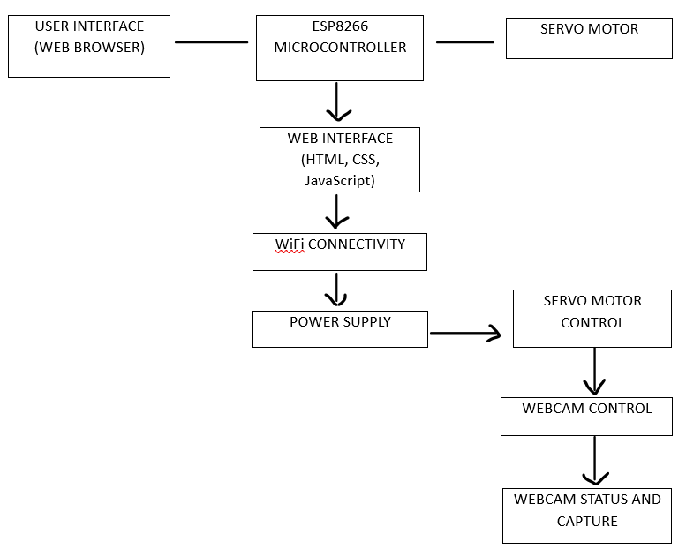
Block diagram

Slide 28
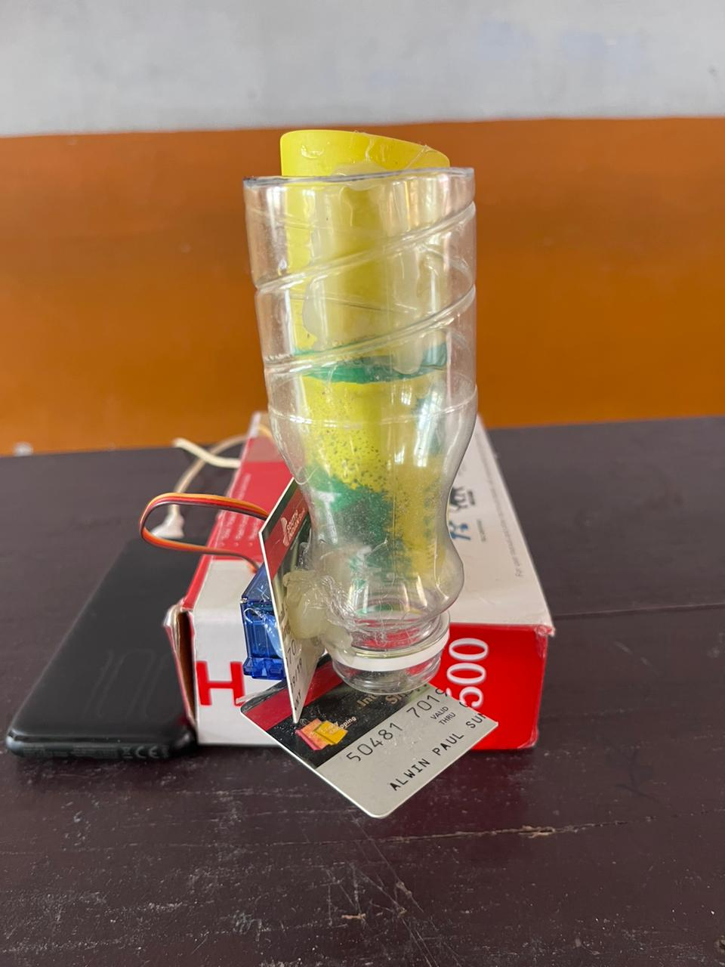
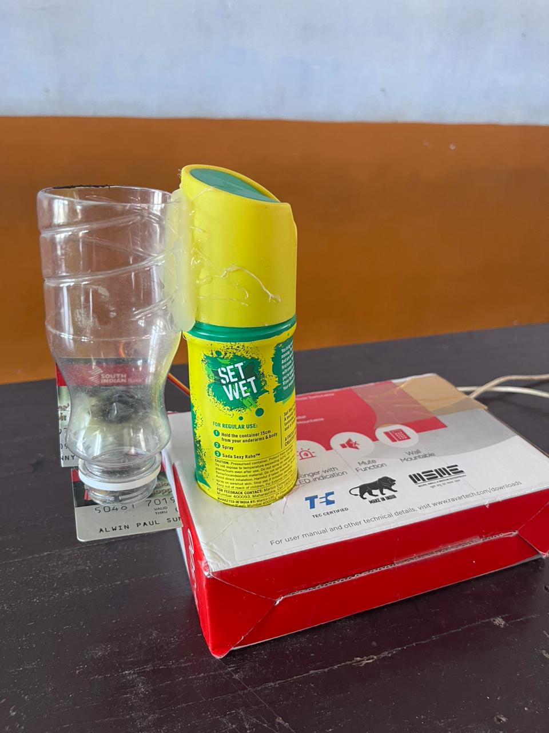

Slide 29
Advantages
1. **Remote control:** users can remotely schedule and control their pet feeder through the web interface, offering convenience and flexibility. 2. **Live monitoring:** the optional webcam feed enables real-time monitoring of pets, enhancing the owner's ability to check on them from anywhere. 3. **Customizable feeding schedule:** the system allows users to set feeding times based on their pets' needs, promoting a personalized and adaptable feeding routine. 4. **User-friendly interface:** the web interface simplifies interaction, making it easy for users to toggle the webcam, control the servo, and adjust feeding frequency settings. 5. **Collaborative development:** the project showcases collaborative effort, with team members contributing to its success, reflecting a shared commitment to the iot mini project.

Slide 30
disadvantages
1. **Security concerns:** the system lacks authentication features, posing a potential security risk as anyone on the same wifi network can access and control the pet feeder. 2. **Limited user interface enhancement:** while the web interface is functional, there's room for improvement in terms of user-friendliness and aesthetics to enhance the overall user experience. 3. **Dependency on local wifi network:** the pet feeder relies on a local wifi network, making it susceptible to disruptions if the network encounters issues or if the user is outside the network range. 4. **Sole reliance on scheduled feeding:** the system primarily relies on scheduled feeding times, lacking sensors for real-time feedback on pet food levels or pet presence, limiting its adaptability to changing circumstances. 5. **Optional webcam feed's bandwidth usage:** enabling the webcam feed may consume additional bandwidth, potentially causing network congestion and affecting other connected devices.

Slide 31
updates
1. Feeder v5.4 (Stable)
Enhanced User Interface
Improved Feeding Controls
2. Cam v4.0 (Stable)
Improved Object Detection Accuracy
Enhanced Feeder Mode Functionality
Optimized Image Processing for Efficiency
User Interface and Status Display

Slide 32
Thank you

